Slide 1

Design and Implementation of Speech Recognition Systems
Fall 2014
Ming Li
Special topic: the Expectation-Maximization algorithm and GMM
Sep 30 2014
Some graphics are from Pattern Recognition and Machine learning, Bishop, Copyright © Springer
Some equations are from the slides edited by Muneem S.

Slide 2
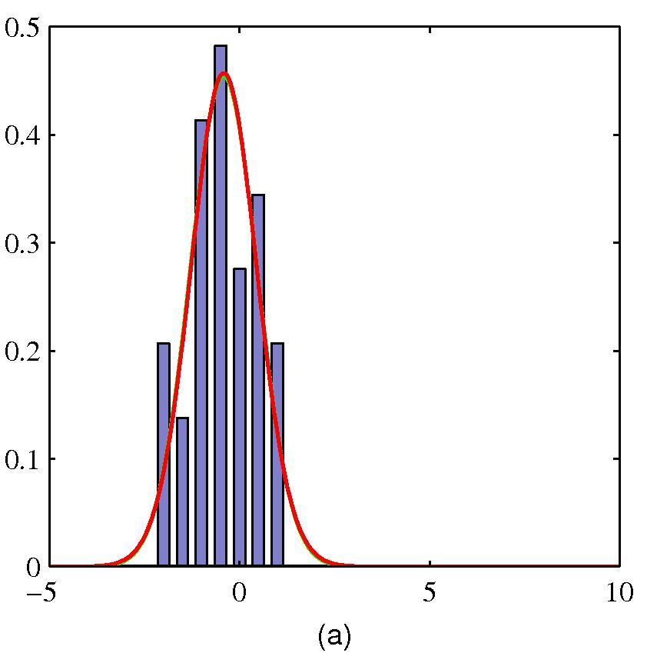
Parametric density estimation
How to estimate those parameters?
ML
MAP

Slide 3
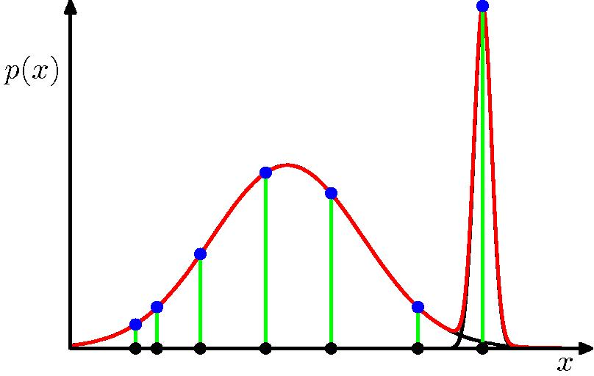
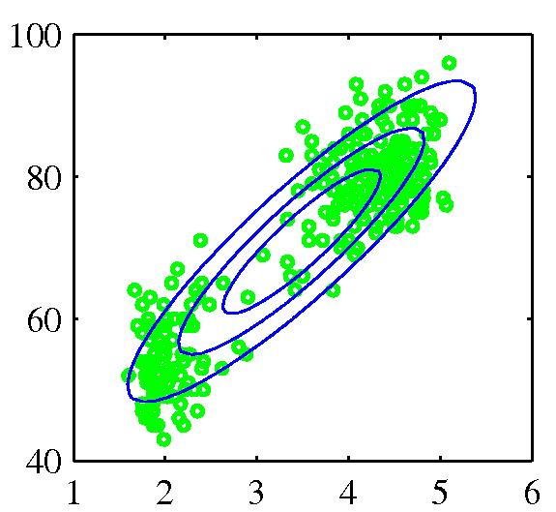
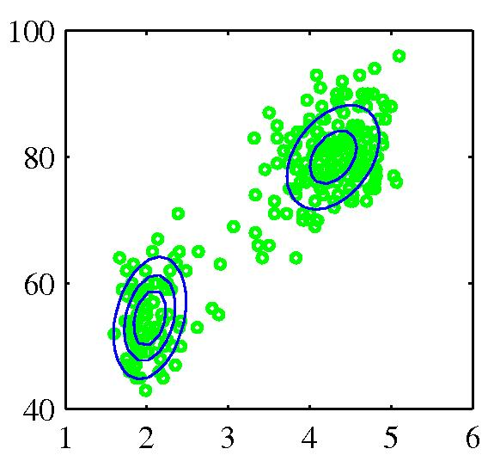
How about Multimodal cases?

Slide 4
Mixture Models
If you believe that the data set is comprised of several distinct populations
It has the following form:
with

Slide 5
Mixture Models
Θ
Let y_{i}∈{1,…, M} represents the source that generates the data.

Slide 6
Mixture Models
Θ
Let y_{i}∈{1,…, M} represents the source that generates the data.

Slide 7
Mixture Models
Θ

Slide 8
Mixture Models
Given x and Θ, the conditional density of y can be computed.

Slide 9
Complete-Data Likelihood Function
Θ
But we don’t know the latent variable y

Slide 10
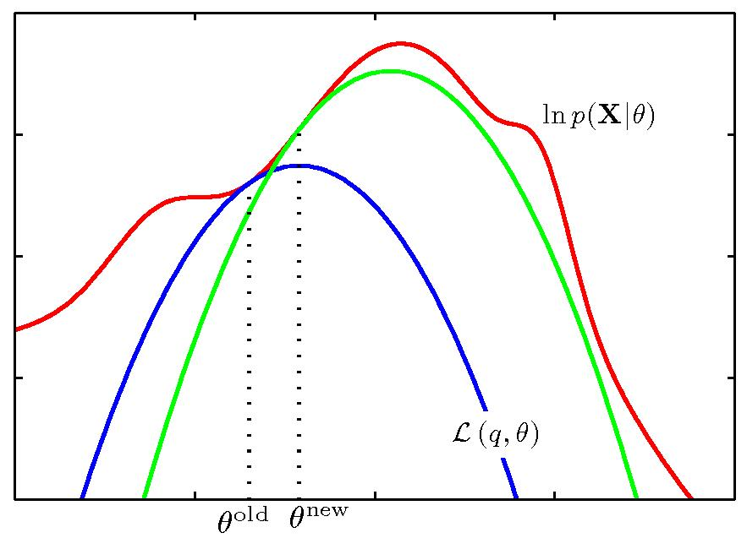
Expectation-Maximization (1)
If we want to find the local maxima of
Define an auxiliary function at
Satisfy and

Slide 11
Expectation-Maximization (2)
The goal: finding ML solutions for probabilistic models with latent variables
Difficult, auxiliary function
Auxiliary function
Log(x) is concave

Slide 12

Expectation-Maximization (2)
What is the gap?

Slide 13
Expectation-Maximization (2)
If we evaluate with old parameters
We have shown that

Slide 14
Expectation-Maximization (3)
Any physical meaning of the auxiliary function?
Independent of
Conditional expectation of the complete data log likelihood

Slide 15
Expectation-Maximization (4)
Choose an initial setting for the parameters
E step: evaluate
M step: evaluate given by
Check for convergence
if not, and return to step 2

Slide 16
Expectation-Maximization (4)

Slide 17
Guassian Mixture Model (GMM)
Guassian model of a d-dimensional source, say j :
GMM with M sources:

Slide 18
Mixture Model
Correlated with θ_{l} only.
Correlated with α_{l} only.
subject to
E step:
M step:

Slide 19
Finding α_{l}
Due to the constraint on α_{l}’s, we introduce Lagrange Multiplier λ, and solve the following equation.

Slide 20
Finding α_{l}
1
N
1

Slide 21
Finding α_{l}

Slide 22
Finding θ_{l}
Only need to maximize
this term
Consider GMM
unrelated

Slide 23
Finding θ_{l}
Only need to maximize
this term
Therefore, we want to maximize:
How?

Slide 24
Finding θ_{l}
Therefore, we want to maximize:

Slide 25
Summary
EM algorithm for GMM
Given an initial guess Θ^{g}, find Θ^{new} as follows
Not converge

